Slide 1



Kelompok 6 RPL : RemindeR
1. Kukuh Yoga Pradana (A11.2018.11111)
2. Yosa Arya Wigiyanto (A11.2018.11113)
3. Diva Madani S. (A11.2018.11021)
4. Muhammad Raihan A. (A11.2018.11100)
5. Bima Ary Widiatmaja (A11.2018.11265)
6. Gigih Yudhamara (A11.2018.11556)

Slide 2
Contributors to gigihyudhamara/PPL4623 · GitHub

Slide 3
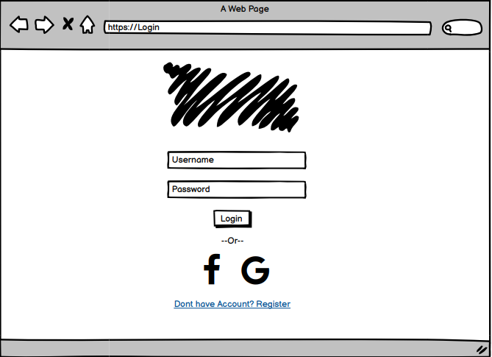
Login Page

Slide 4
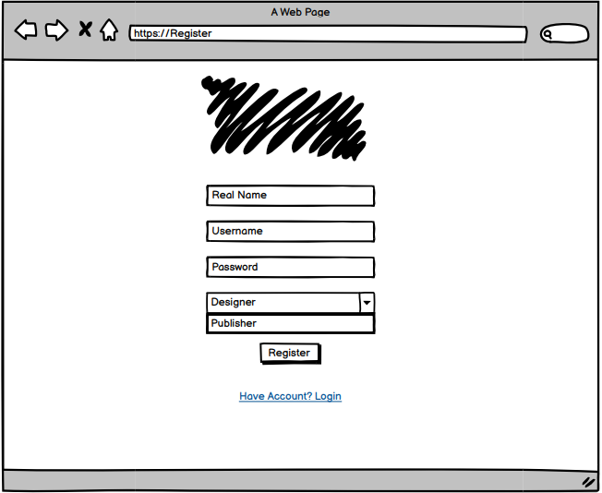
Register

Slide 5
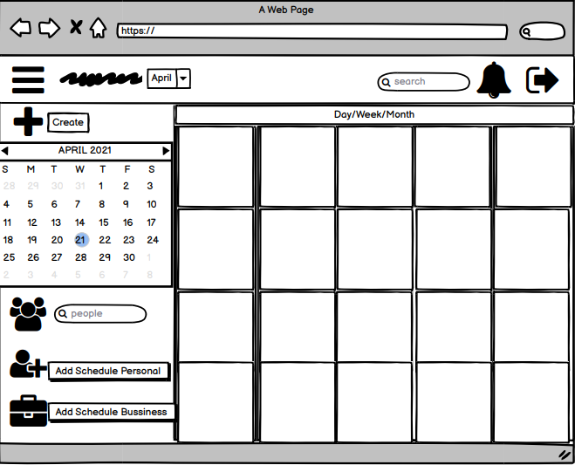
Dashboard

Slide 6
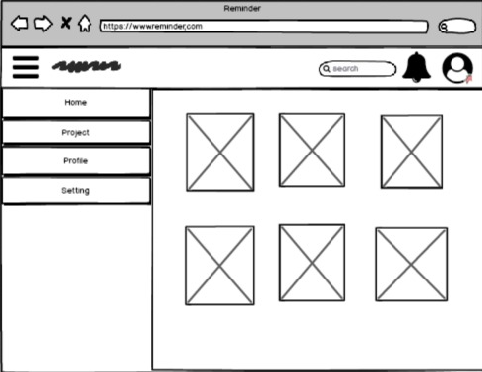
Home

Slide 7
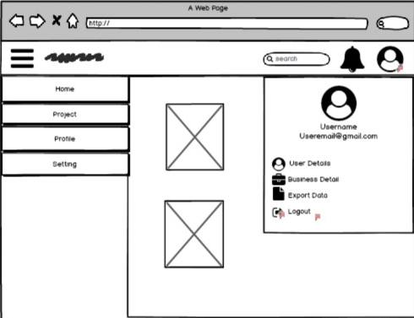
User Account

Slide 8
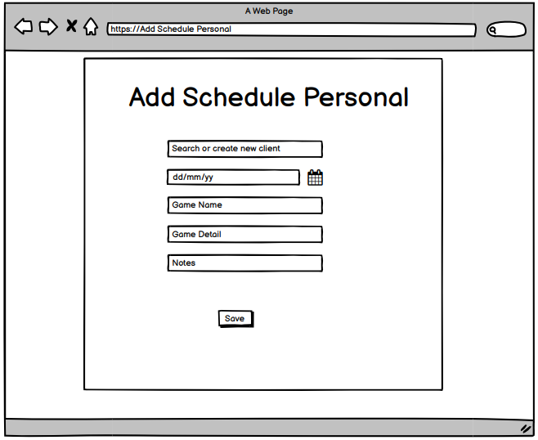
Add Schedule Personal

Slide 9
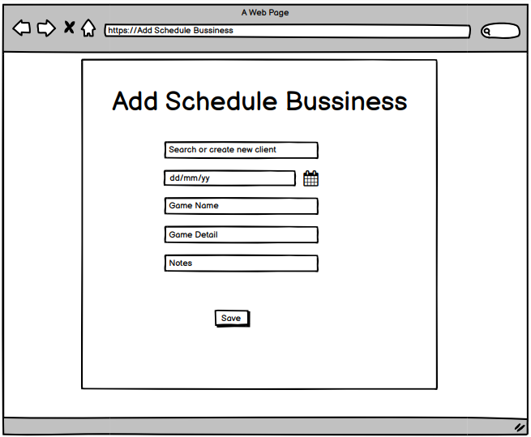
Add Schedule Bussiness

Slide 10

Thank You

